Slide 1
Class: Digenea
Digenia has two suckers and attached organ.
A. oral (usually anterior) sucker. Surrounds mouth.
B. acetabulum (ventral sucker).
Two or more hosts involve in the life cycle, but few is monecious (self-fertilized).
Types of adult flukes according to the sucker as name and position:
1- distome (most common; oral sucker and ventral acetabulum).
2- amphistome (oral sucker; posterior sucker, usually posterior to testes).
3-monostome (oral sucker only).
4-gasterostome (mouth in center of oral, ventral sucker).
5-holostome (forebody and hindbody; tribocytic organ posterior to acetabulum).
6-echinostome (collar of spines around anterior sucker).

Slide 2
Tegument consist of two zones:
1. outer cytoplasmic syncytium provided with microvilli [mitochondria, ER,
vacuoles, lipids, etc.] [pinocytosis; spines]
2. inner area of nucleated cell bodies – cytons.
3. zones separated by basal lamina.
4. circular & longitudinal muscle under basal lamina.
Numerous chemicals in the tegument:
• mucopolysaccharides to inhibit host digestive enzymes.
• acid & alkaline phosphatases, esterases, and aminopeptidases for digestion.

Slide 3
Alimentary tract consists of:
• incomplete gut.
• pharynx, when present, masticates food.
• esophagus leads to 2 blind cecae.
• entire gut secretion by cells along gut; proteases, lipases.
• in cecae, absorption process.
* Belongings species usually feed on blood, mucus, and epithelium cells.
Reproductive system consists of:
• Male reproductive system consists of: usually 2 testes; taxonomic importance, vas efferens - vas deferens - cirrus pouch, cirrus pouch encloses seminal vesicle, prostate glands, and cirrus; some with external seminal vesicle outside of pouch, sperm stored in seminal vesicle and prostate secretes fluid to keep sperm alive.

Slide 4
• Female reproductive system consists of:
usually single ovary, 2ndry oocytes released, through short oviduct, into ootype, 3 organs enter into ootype: Mehlis gland, cluster of unicellular glands, enhance egg tanning by maintaining correct pH. Different cell types in gland, secretions cause release of shell globules from vitelline glands, secretes first membrane around egg into lubricates uterus and activates sperm, which are passed down ootype. Common vitelline duct (passage of vitelline gland secretions for eggshell formation), Duct from seminal receptacle (absent in some species), Occasionally a fourth duct, vitelline reservoir, as diverticulum of vitelline duct.

Slide 5
Excretory system consists of:
• protonephridia (flame cells).
• excretory bladder in posterior, with excretory pore.
Development:
• Egg: usually operculate, lid pops off during hatching (in Schistosomes, no lid; shell splits).
• Miricidium: hatches from egg and then penetrates mollusc (rarely annelids), and develop as asexual stages from miricidium, with morphologic characteristics: apical stylet, apical papilla [where ducts from glands open; also nerve endings for chemoreception], apical gland [histolytic enzymes], cephalic glands [lytic
enzymes], photoreceptors [eyespots], germinal mass [initiate asexual stages], cilia [locomotion], excretory pore, actively swim, chemoreception to snail mucus, attaches to snail with apical papillae; lytic enzymes dissolve tissues. About 30
minutes for penetration

Slide 6
Sporocyst: it is asexual stage with various shapes but does not have a mouth or digestive system, absorbs nutrients through tegument, may produce rediae, daughter sporocysts, or cercaria.
Redia: can develop directly from miricidium, or from embryos generated from sporocysts, elongate; crawl actively, muscular pharynx, mouth, blind-ended sac caecum, 1-more ambulatory buds for movement often, because ingestion, many species cause extensive damage to host, will form daughter rediae or cercaria.
Cercaria: emerged from redia or sporocyst, free-swimming, leaves snail and seeks host, miniature immature fluke with tail, penetrate skin of definitive host, encyst on vegetation as metacercaria, encyst as metacercaria in intermediate host or eaten by intermediate or definitive host or mesocercaria (unencysted juvenile) in tissues

Slide 7
Classification based on sucker placement of cercaria
• monostome
a. 1 sucker only, anterior
b. 2 eyespots
c. long, simple tails
d. develop from redia
e. give rise to monostome adults
• amphistome
f. posterior sucker, often anterior too
g. eyespots
h. develop from redia
i. give rise to amphistome adults
j. all in superfamily: Paramphistomoidea

Slide 8
gasterostome
k. mouth ventral
l. develop into gasterostome adults
m. all in family: Bucephalidae
• distome
n. 2 suckers, one oral and one ventral
o. most common type
Additional classification, based on cercarial tail shape and other structures:
• pleurolophocercous
• furcocercous
• echinostome
• xiphidiocercariae
• ophthalmocercariae (with eyespots)

Slide 9
Trematoda is divided according to the site of infection in the definitive host:
1- Liver Flukes
2- Intestine Flukes
3- Lung Flukes
4- Blood Flukes

Slide 10
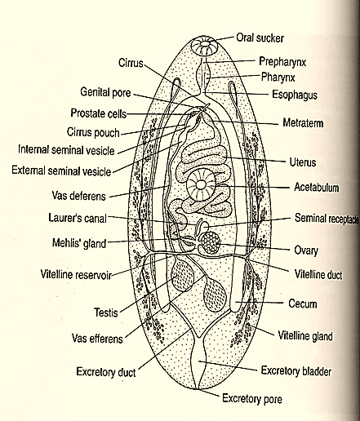
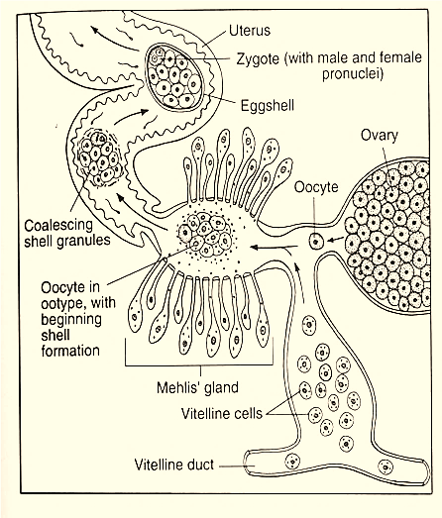



Slide 11
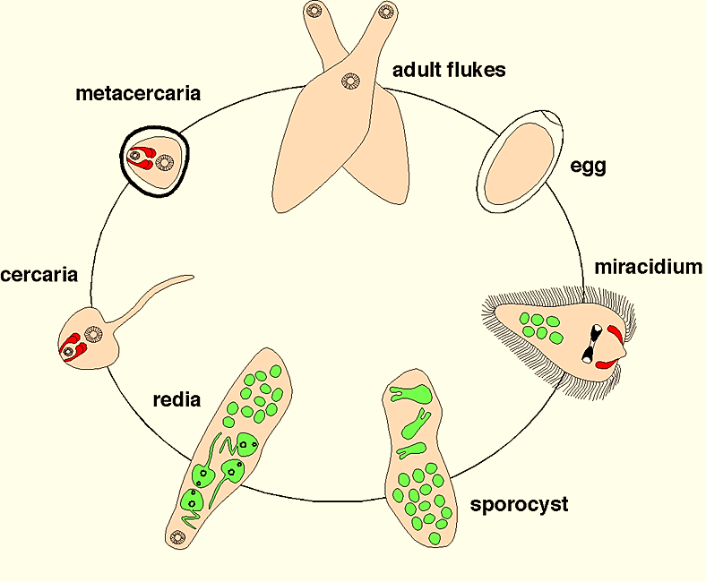


Slide 12
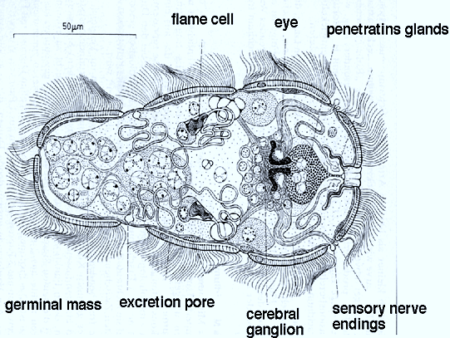
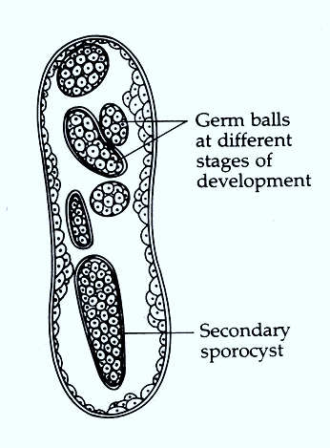



Slide 13
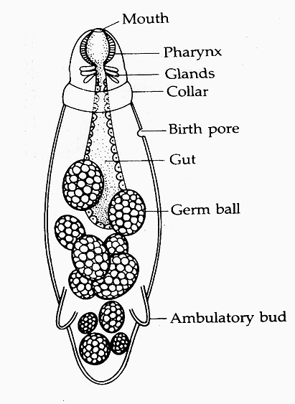
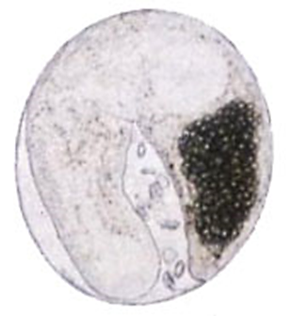



Slide 14
THANK YOU

